Slide 1
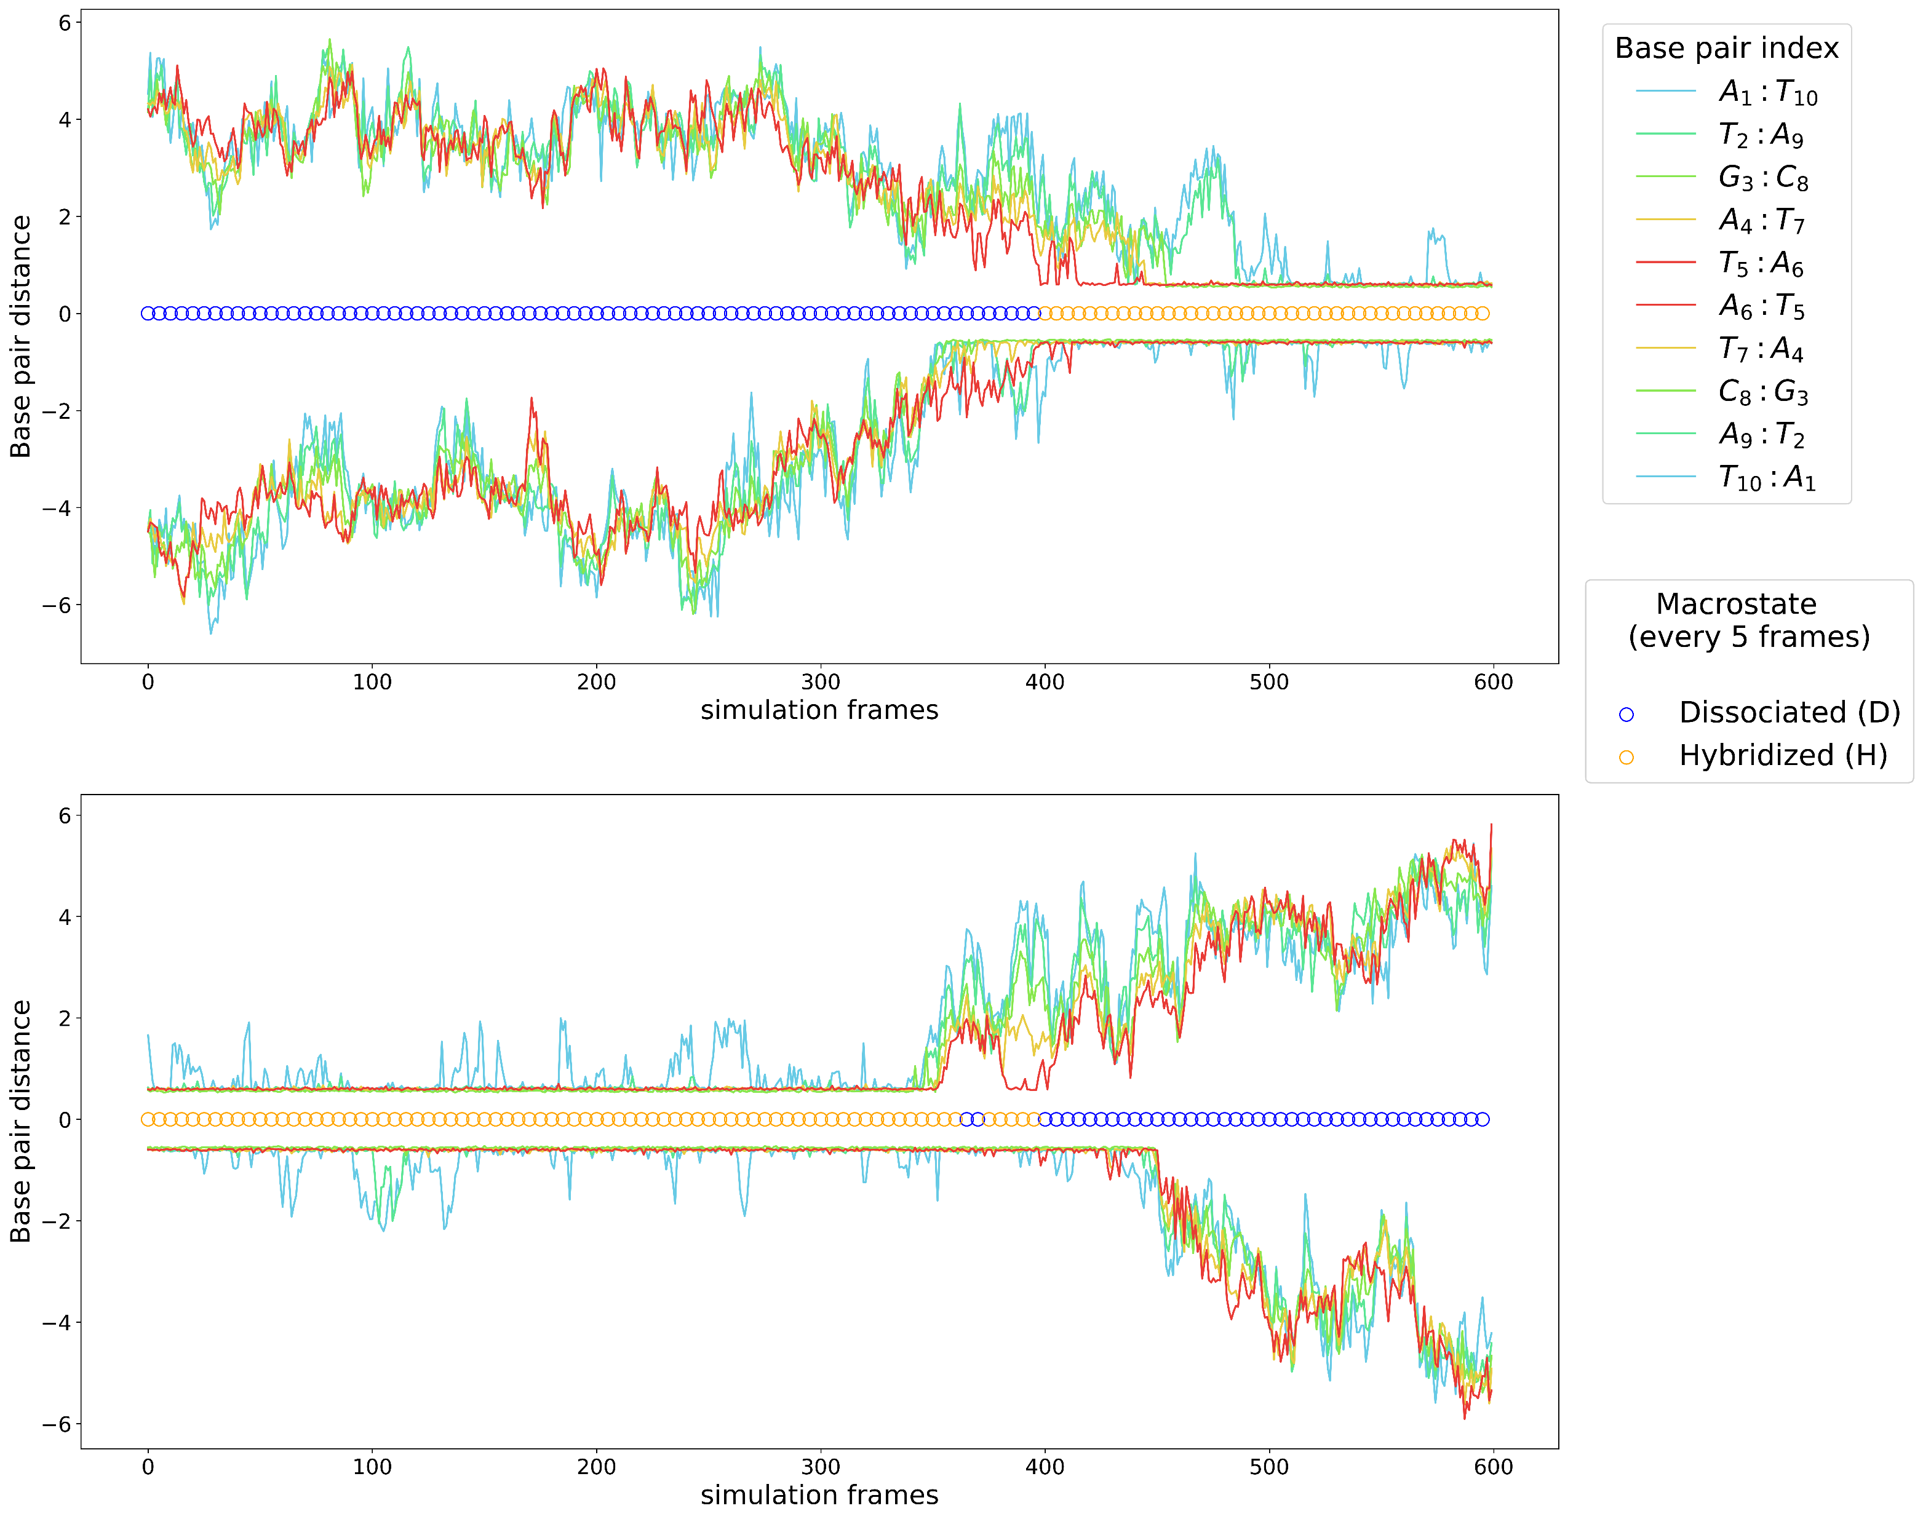
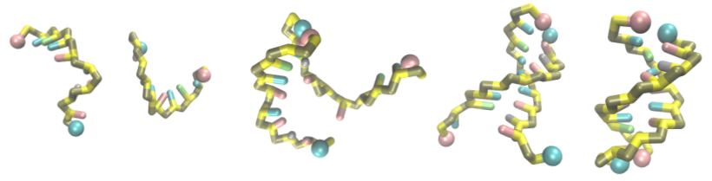
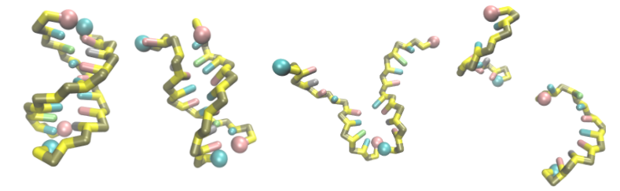

Slide 2
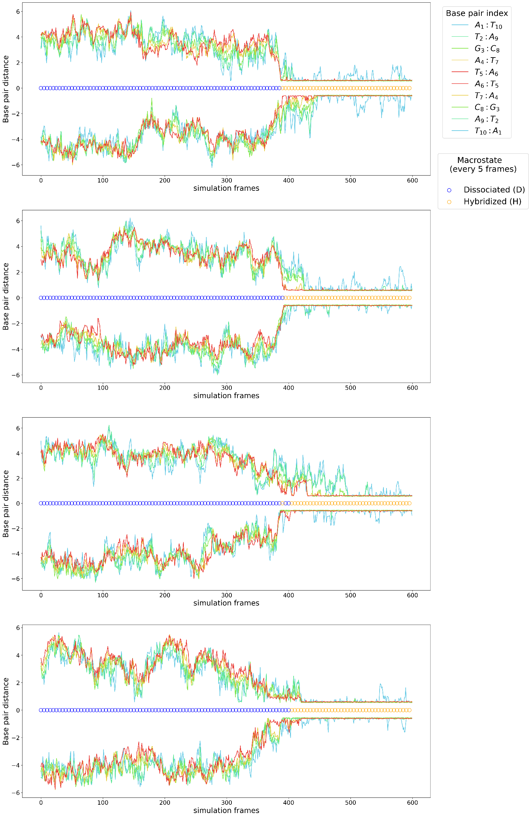
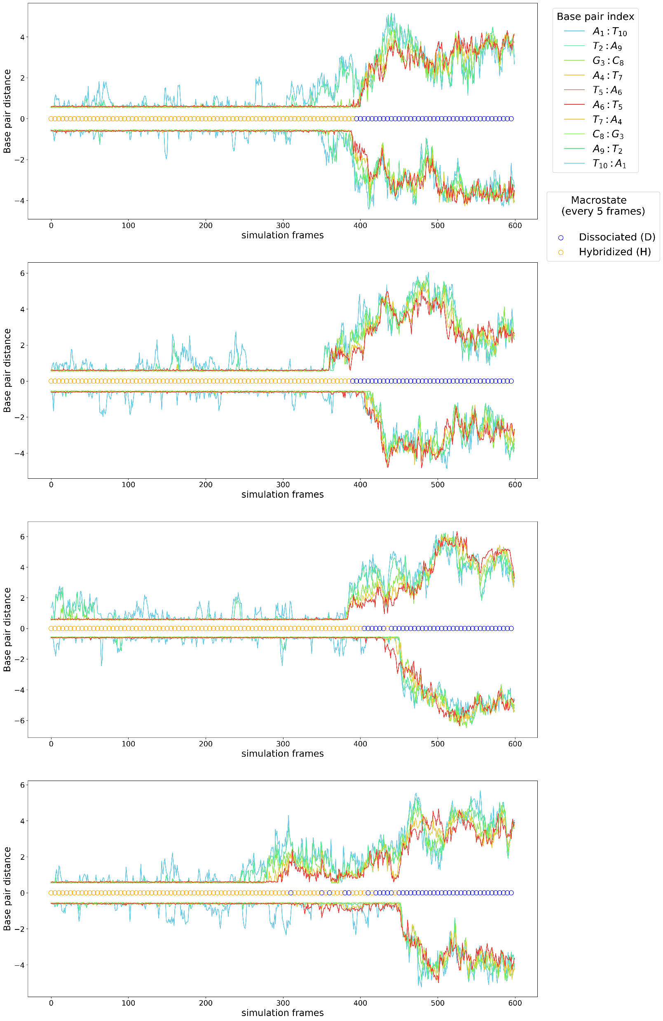
Supplemental GC-mix
a
e
b
f
c
g
d
h

Slide 3
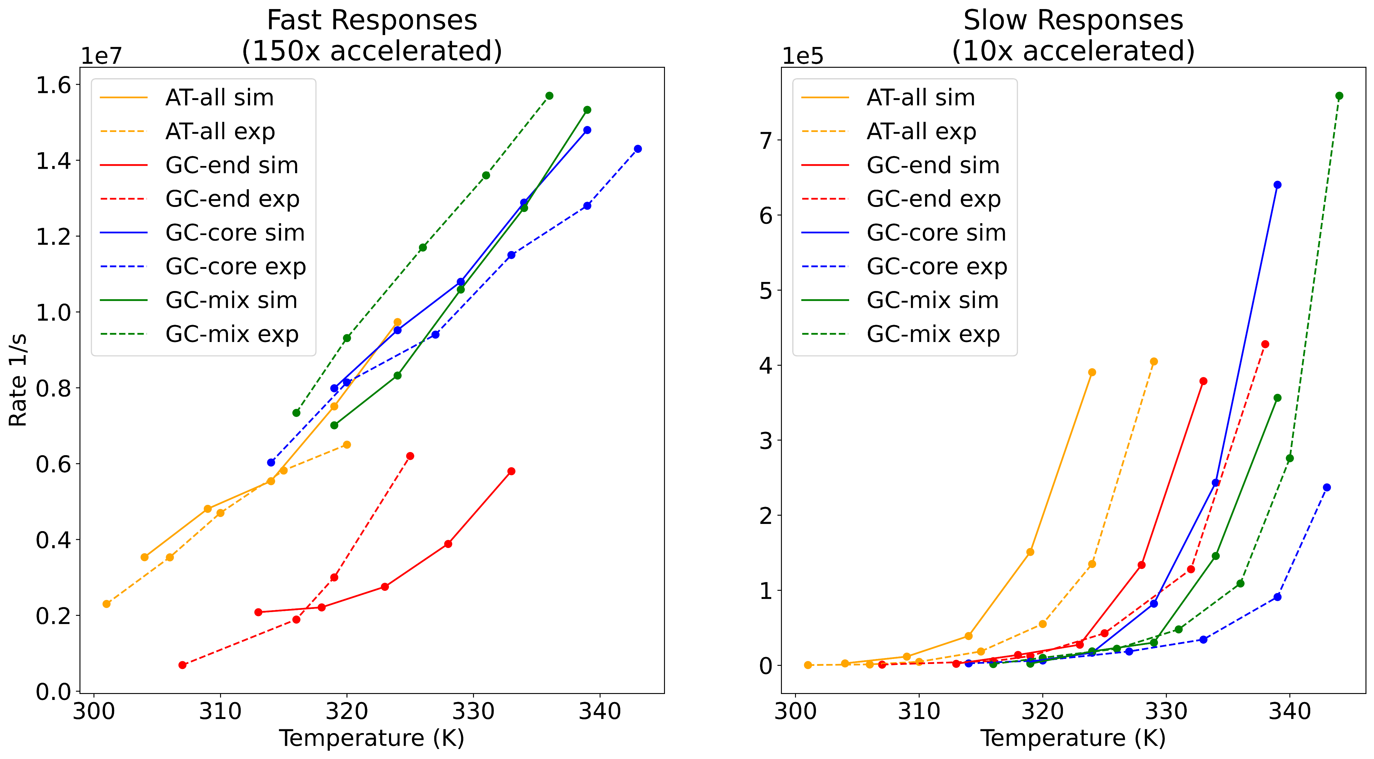
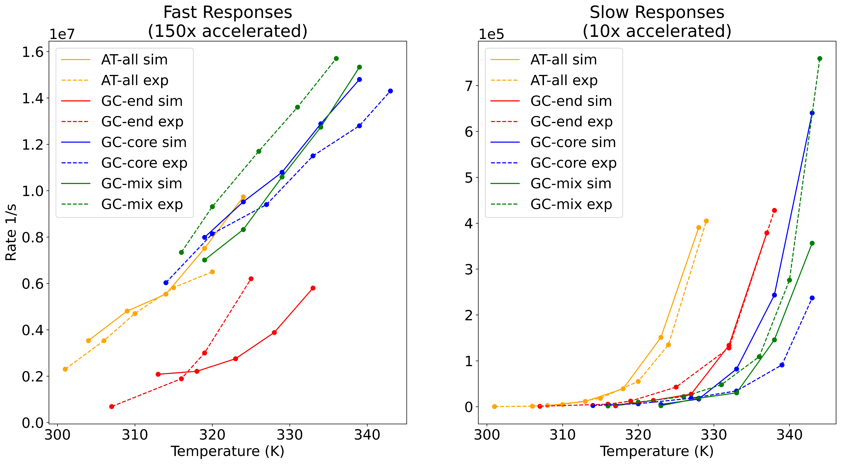
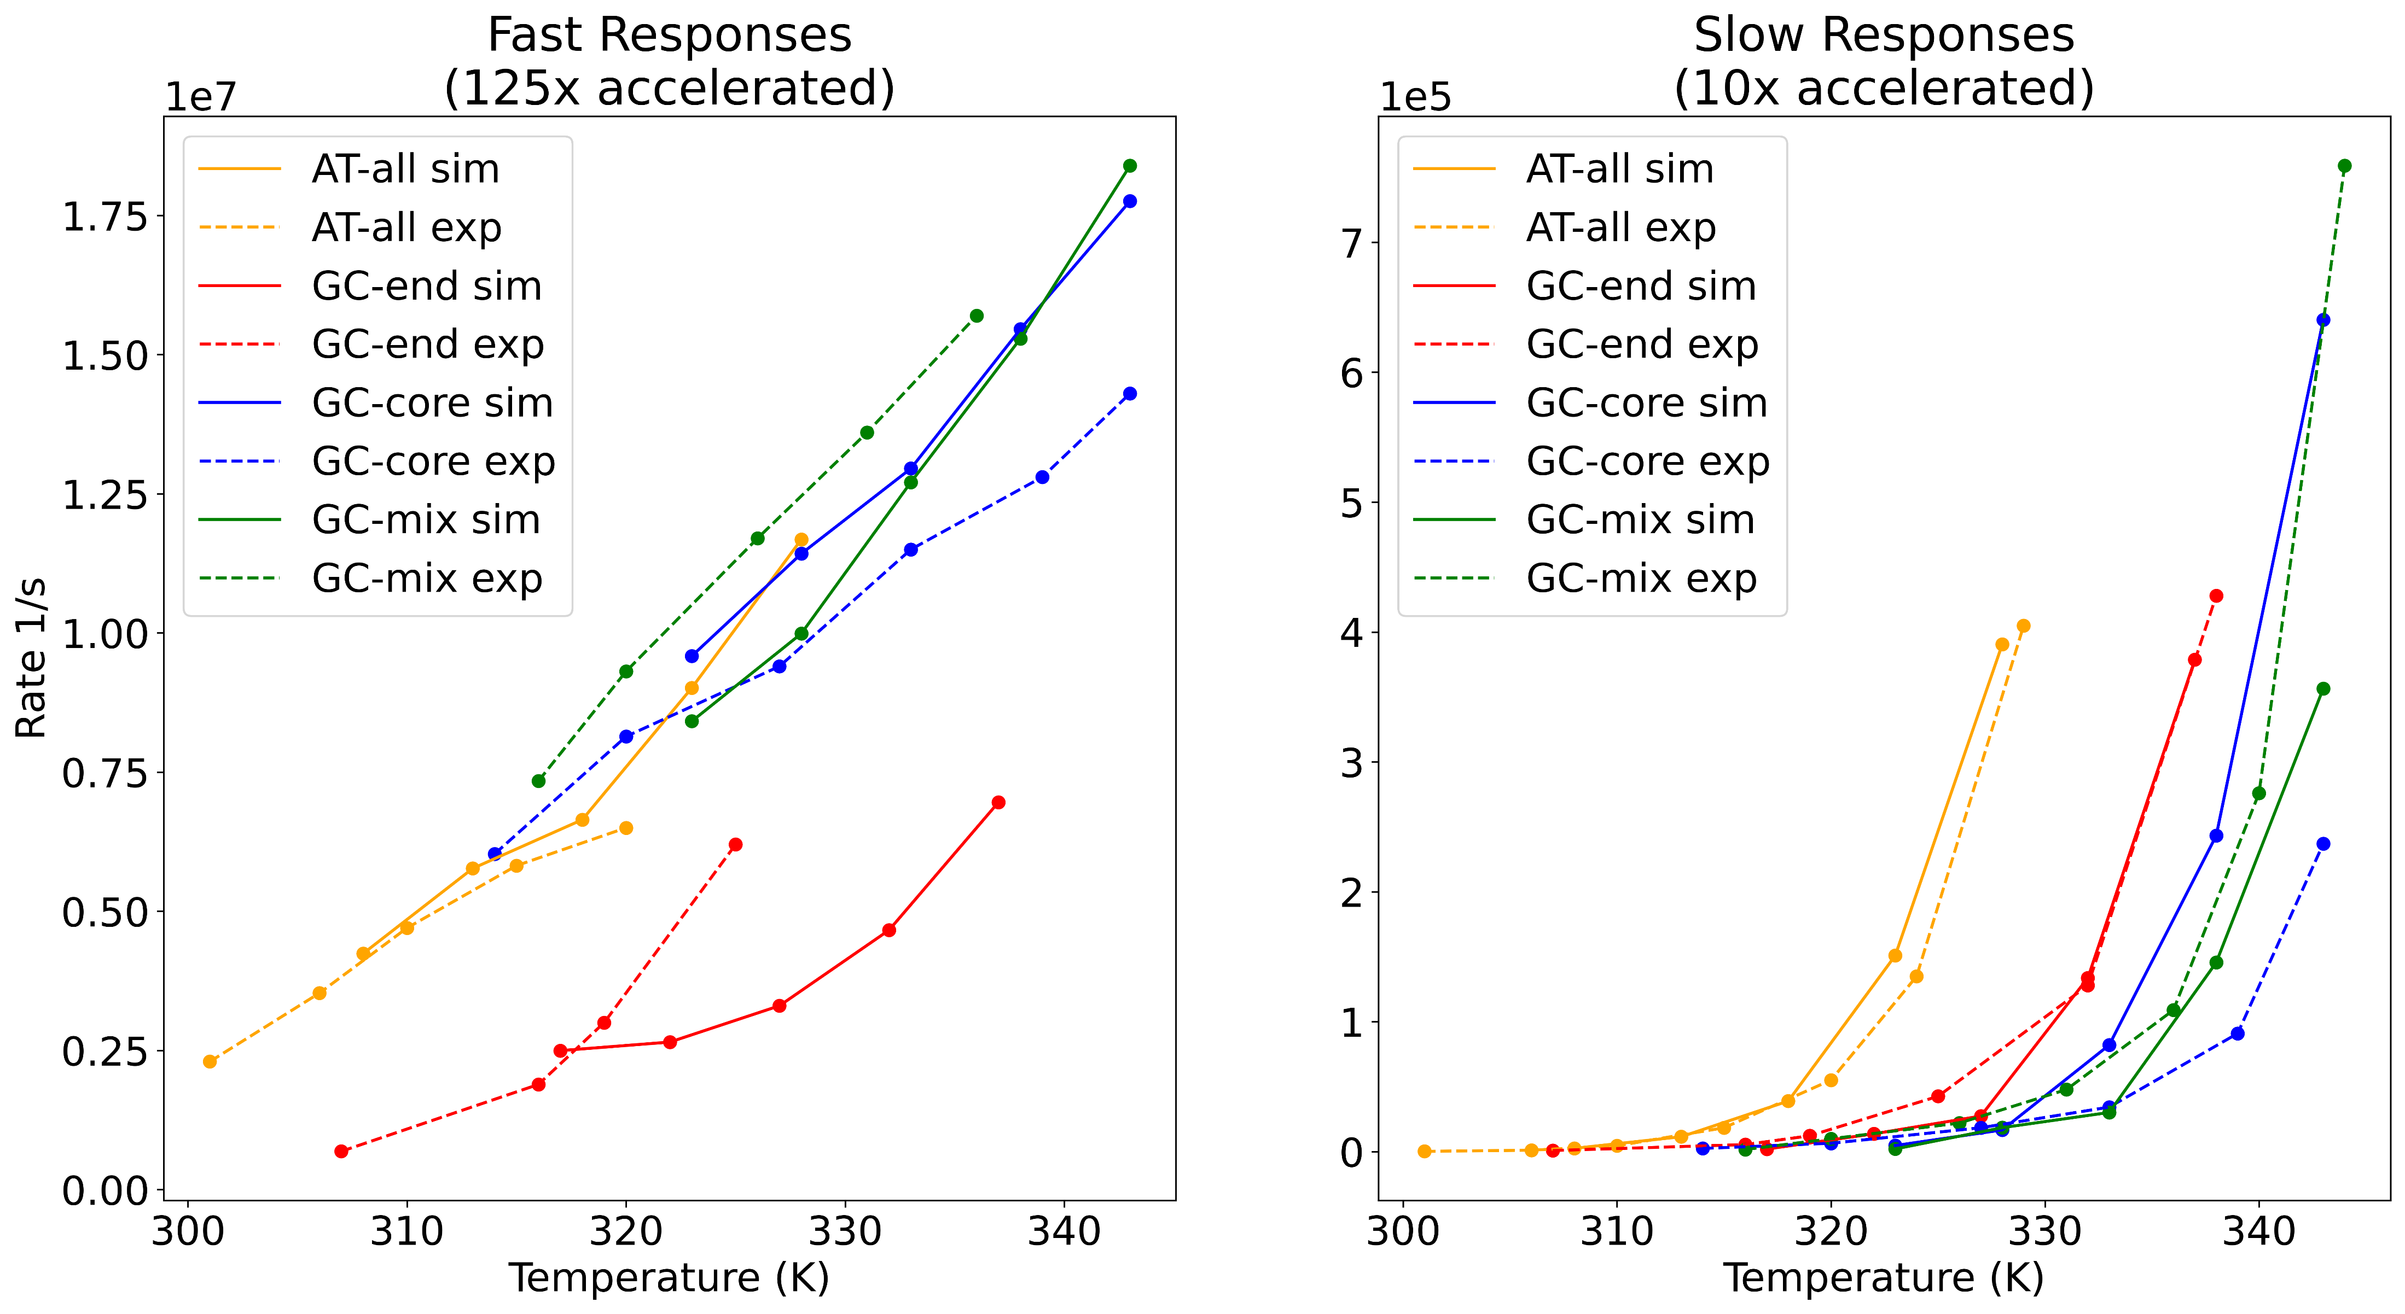
Shift Neither
Only shift slow
Shift Both

Slide 4
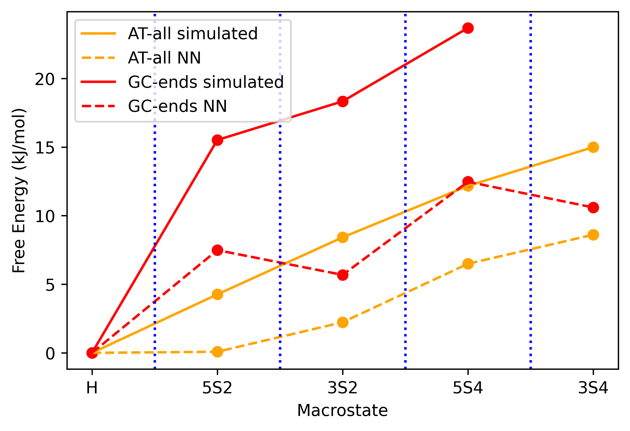
Can add a dissociated state, but need to check with Brennnan on entropy calculation.
F4 state is not visited by either AT-all or GC-end
Color are consistent with previous plots, but are not the most appealing when just AT-all and GC-end

Slide 5
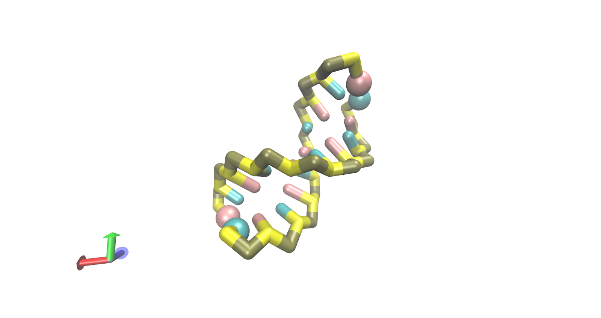
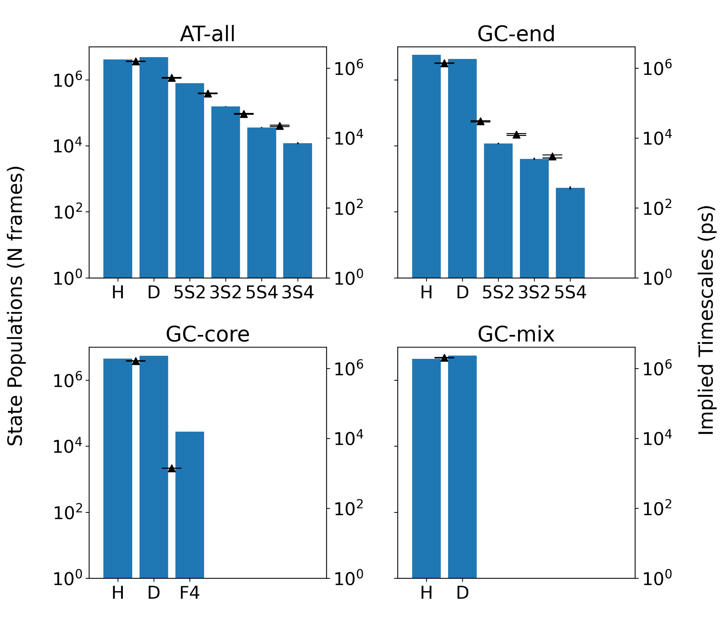
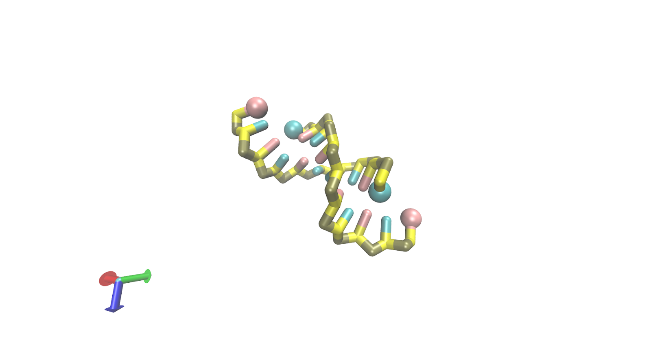
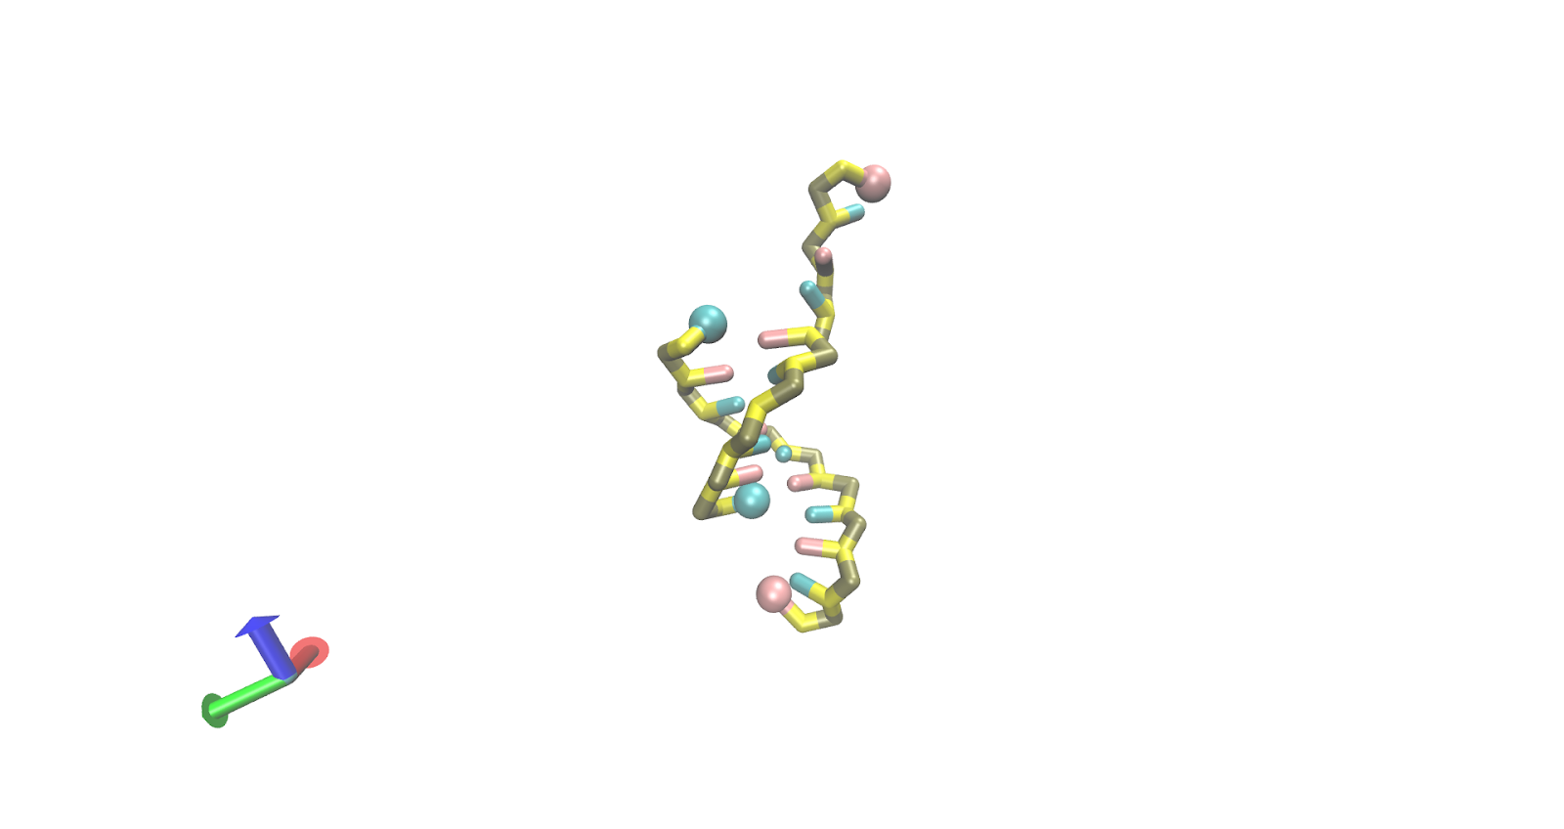
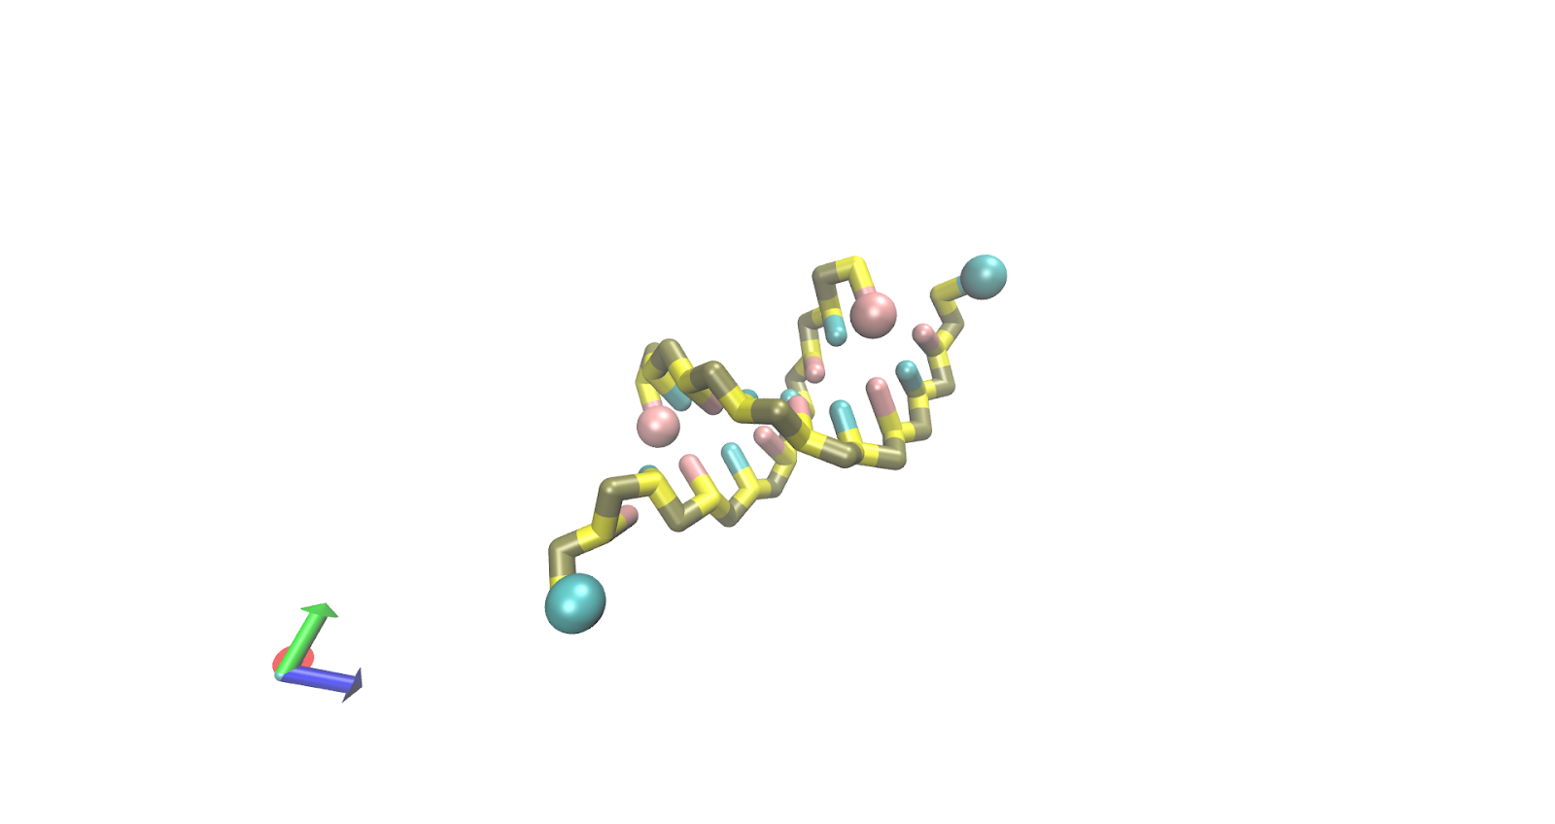
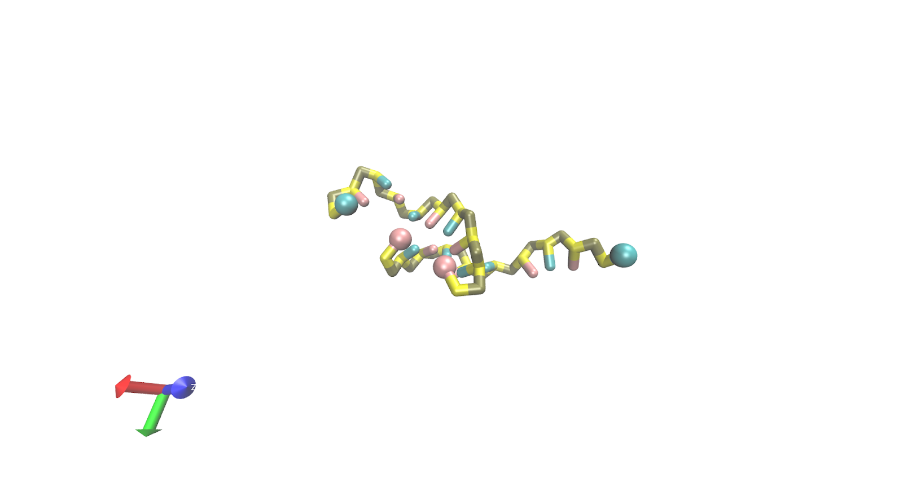
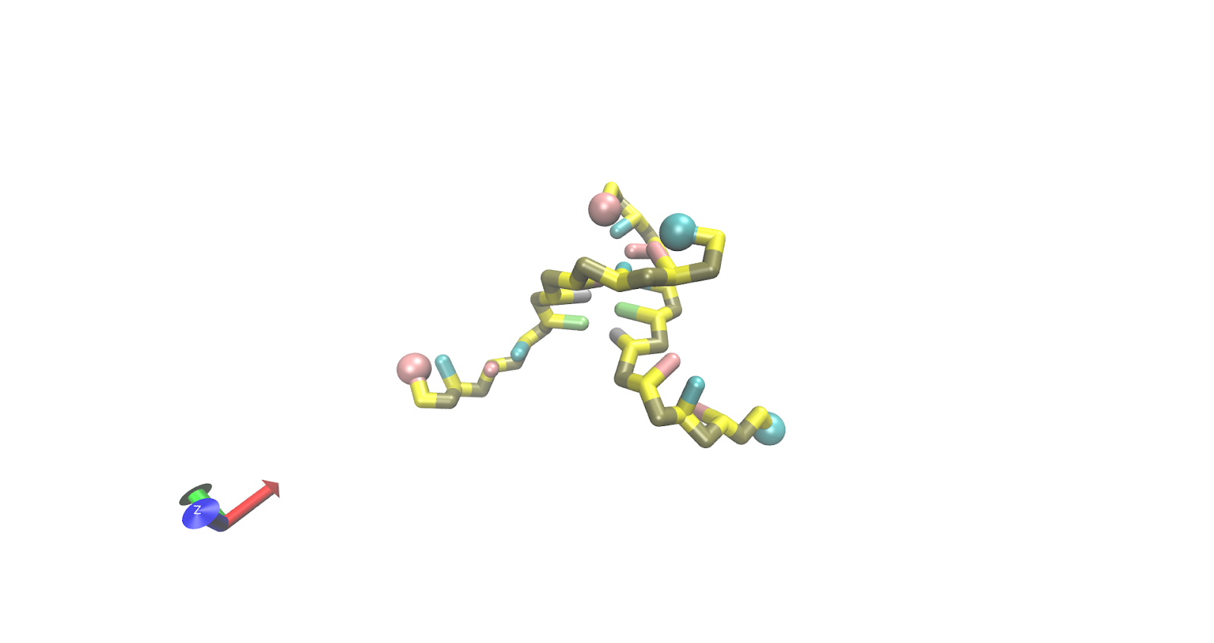
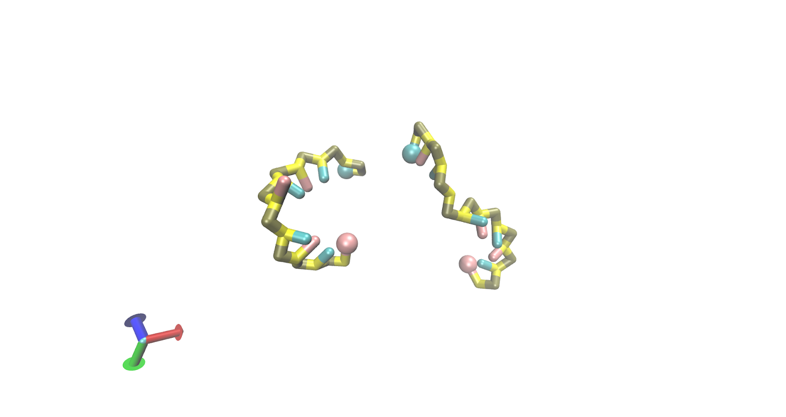
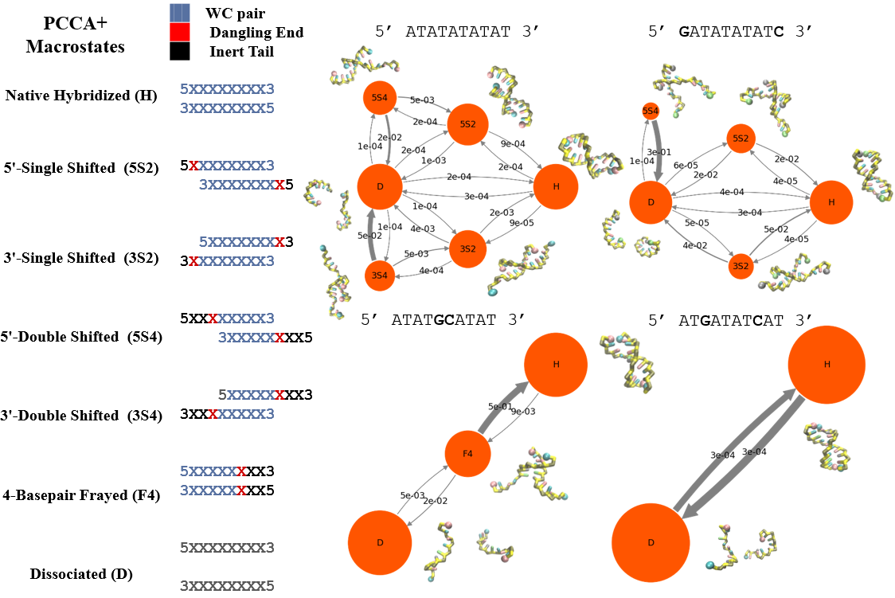
Macrostates
H (Native Hybridized)
5S2 (5’-2bp Shifted)
3S2 (3’-2bp Shifted)
5S4 (5’-4bp shifted)
3S4 (3’-4bp Shifted)
F4 (4bp Frayed)
D (Fully Dissociated)
Probabilities and Timescales
5--------3
3--------5
I realized that it may be helpful to overlay the probabilities and timescale since they are related quantities. Both are
Amenable to log scales, although I’m not sure the best way to compare units. Because the log of probabilities (free energies) will have the inverse trends, I instead plotted the number of frames in each state (similar to how transition circles are determined) which corresponds to the left axis. The timescales are in ps (simulation time no correction) and are shown on the right axis. I plot these between the population bars to show that they reflect transitions between states (always n states -1). It is a coincidence that the values are nearly on the same scale.
5--------3
3--------5
5--------3
3--------5
5--------3
3--------5
5--------3
3--------5
5--------3
3--------5
5--------3
3--------5
MSMs

Slide 6
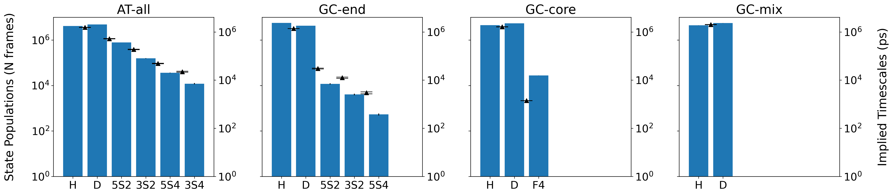
Macrostates
H (Native Hybridized)
5S2 (5’-2bp Shifted)
3S2 (3’-2bp Shifted)
5S4 (5’-4bp shifted)
3S4 (3’-4bp Shifted)
F4 (4bp Frayed)
D (Fully Dissociated)
MSMs
5--------3
3--------5
Same info as previous slide, making MSMs larger and removing additional vmd rendering for each microstate
5--------3
3--------5
5--------3
3--------5
5--------3
3--------5
5--------3
3--------5
5--------3
3--------5
5--------3
3--------5
Probabilities and Timescales

